Slide 1
25th Anniversary Celebration
All American BBQ
Wednesday, June 17, 2009

Slide 2
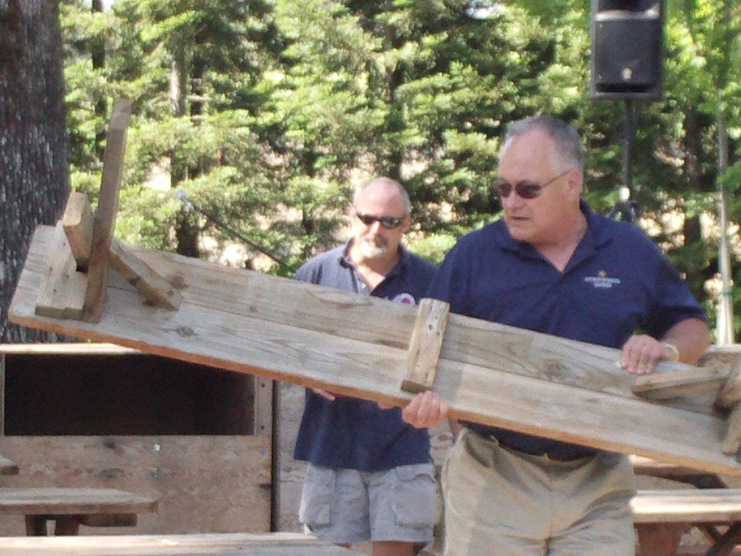
Setting Up

Slide 3
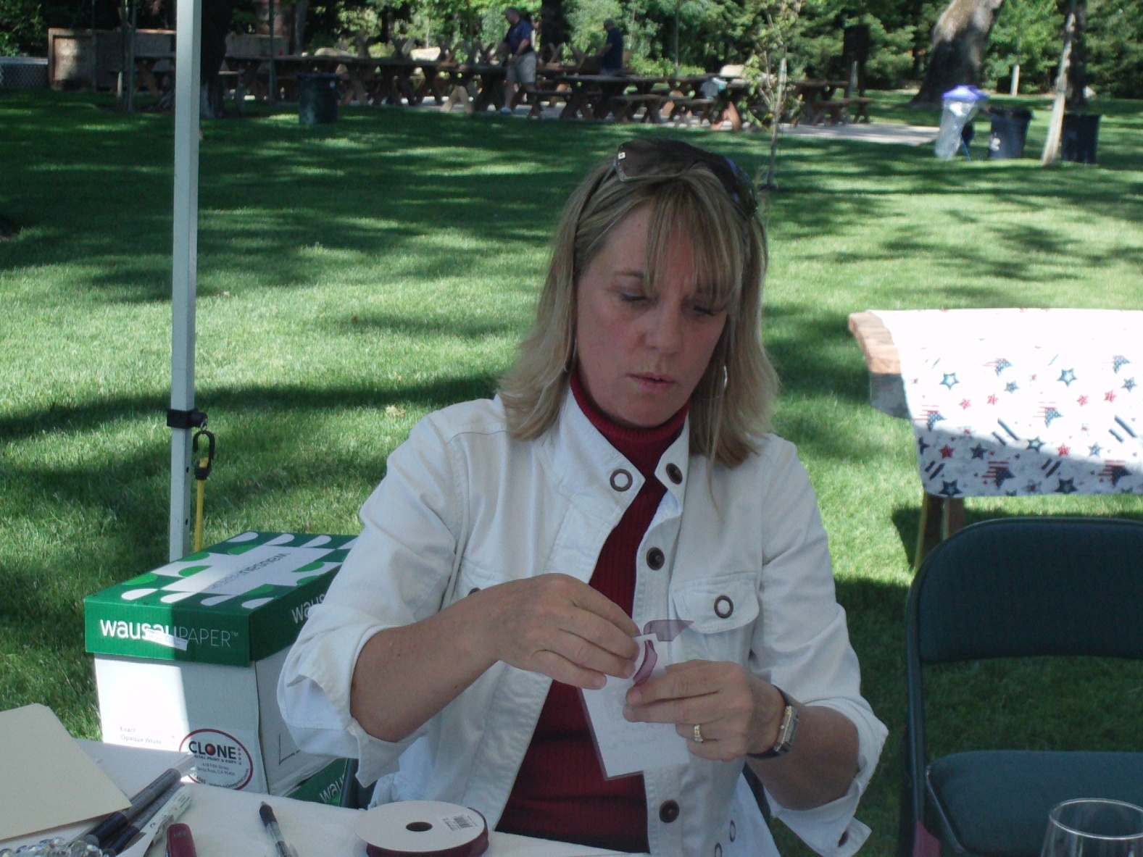
Collecting Names & Taking Tickets

Slide 4
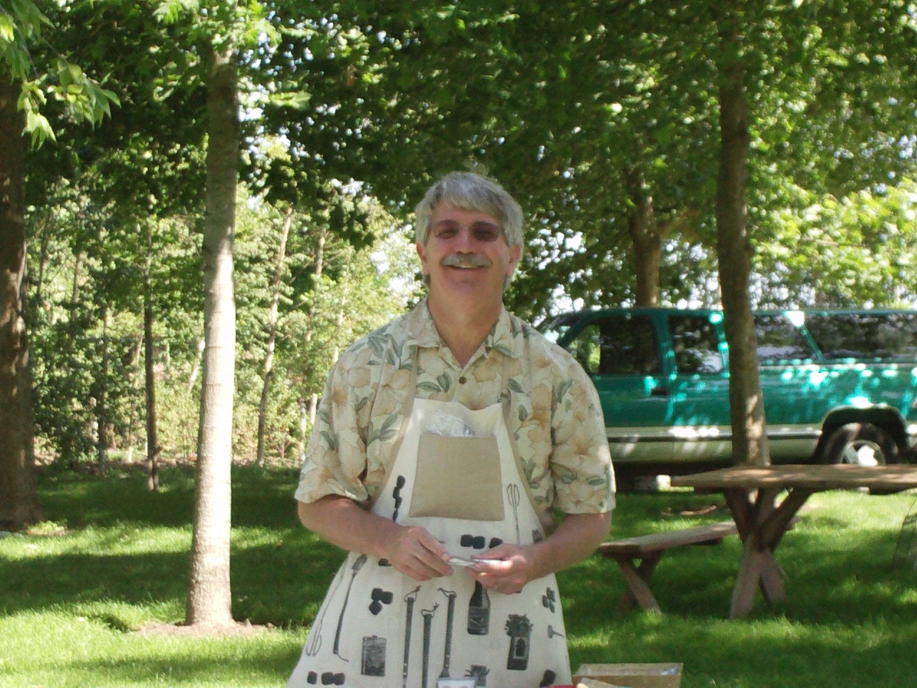
Kiss the Cook?

Slide 5
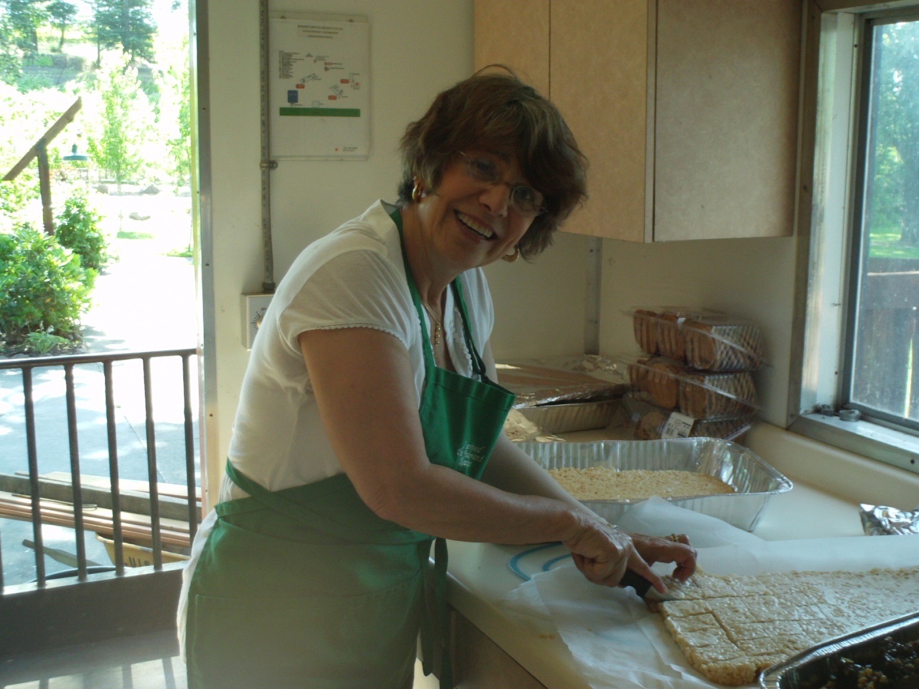
Prepping
Takes
Time

Slide 6
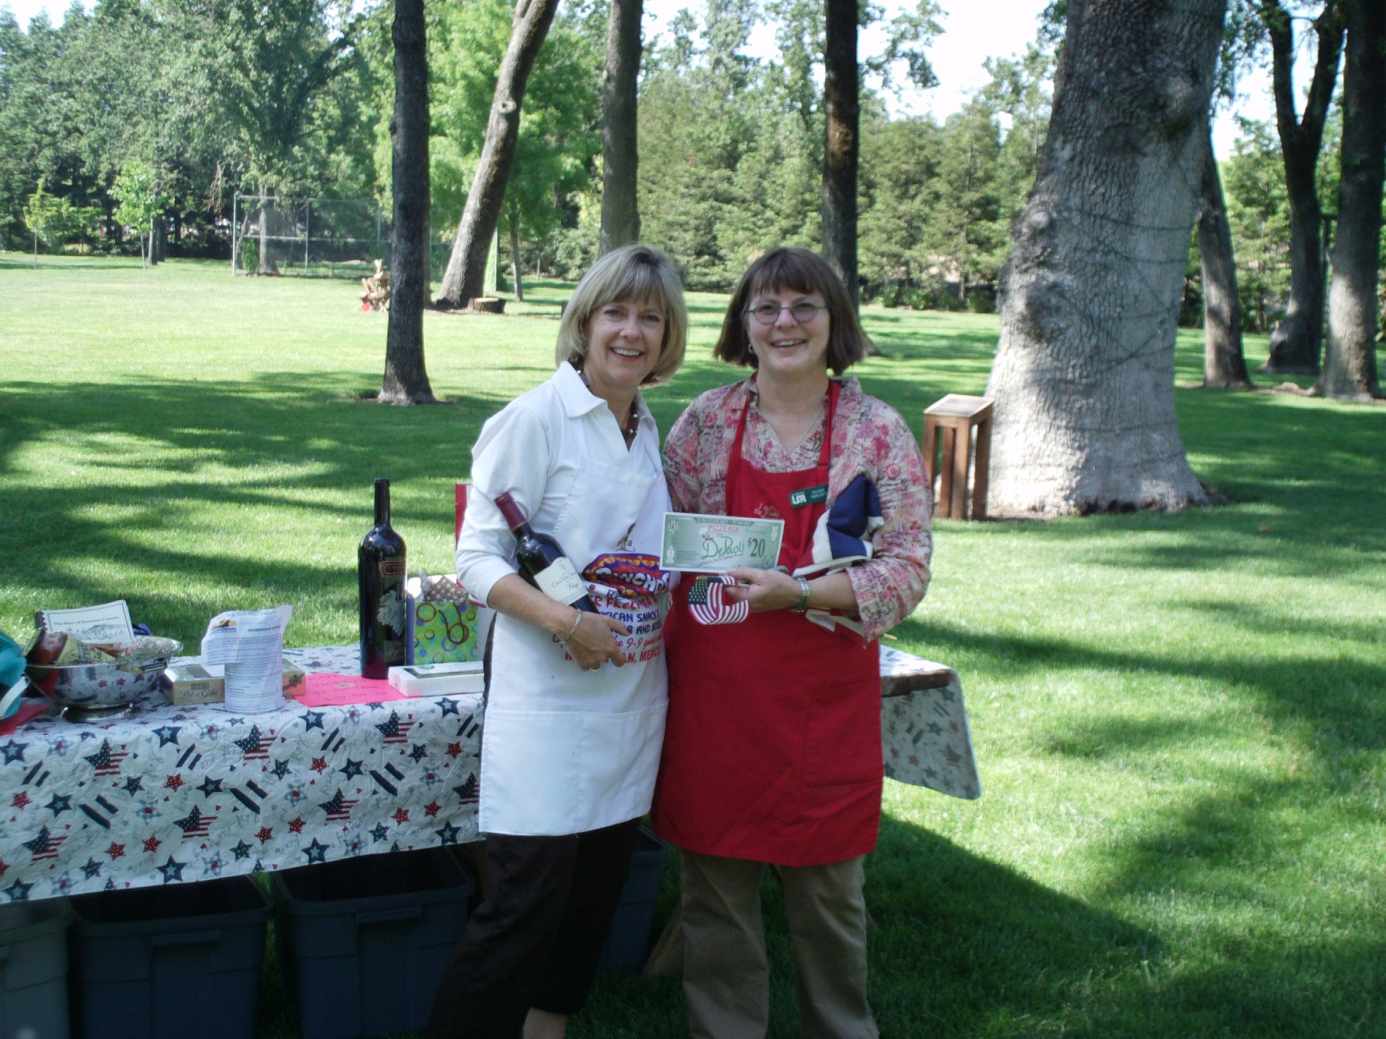
Checking Out the Prizes

Slide 7
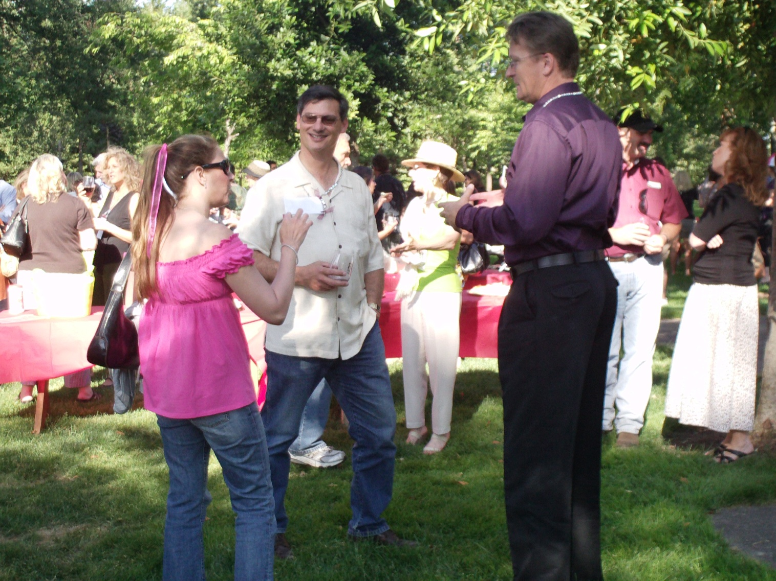
Catching
Up On
the News

Slide 8
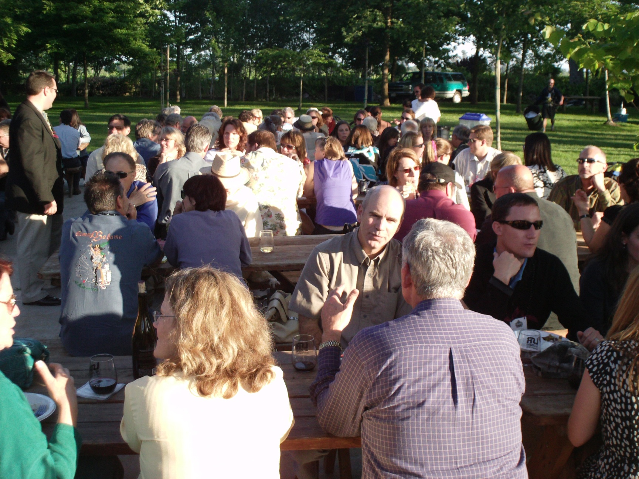
Let’s eat

Slide 9
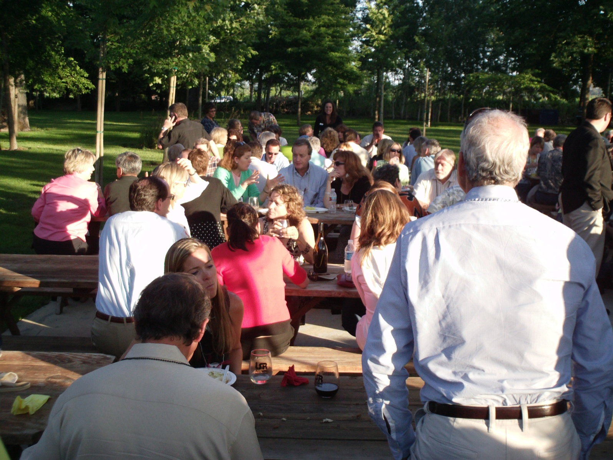
Enjoying
Food
&
Company

Slide 10
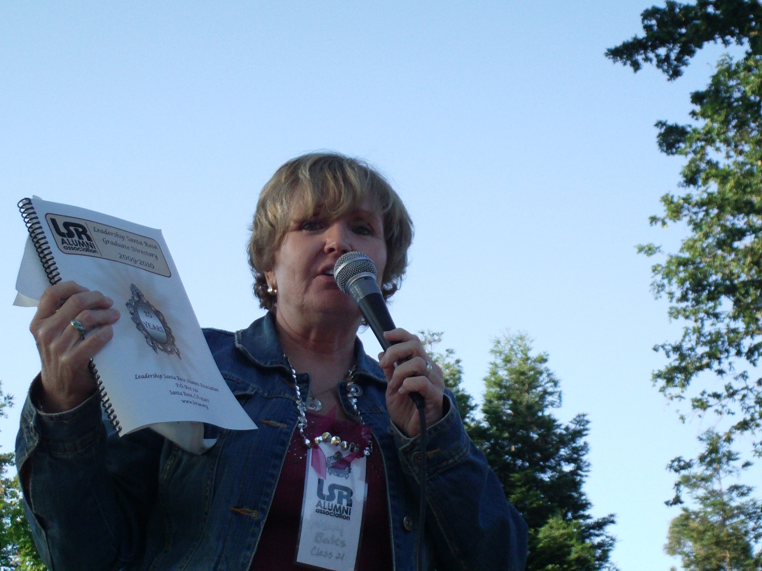
The Announcements Cometh

Slide 11
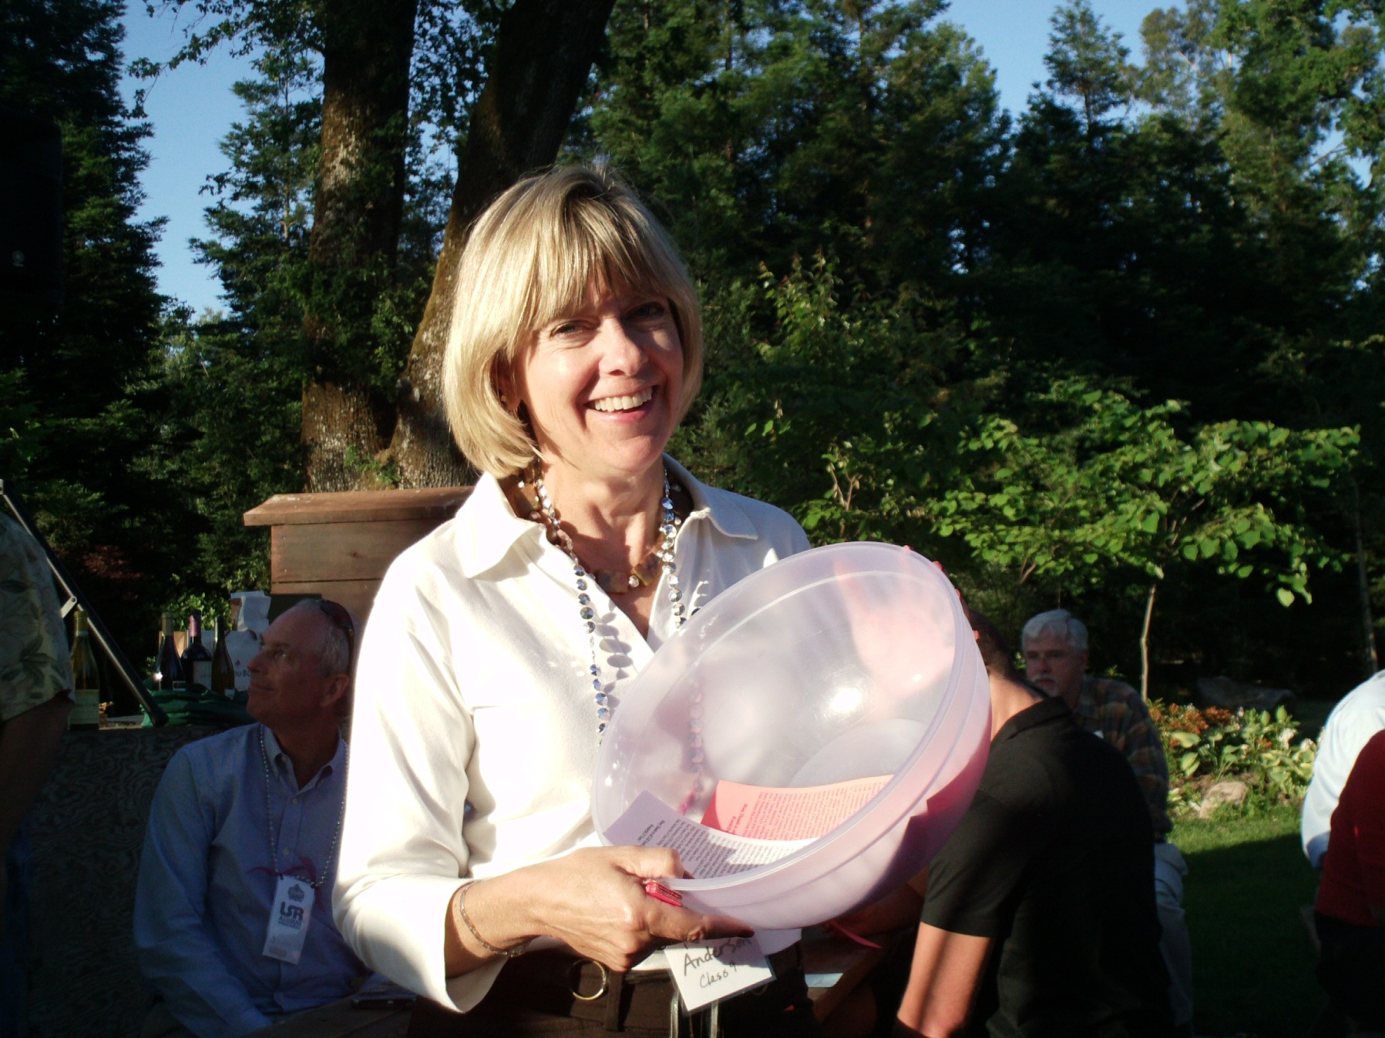
Are You Ready To Raffle?

Slide 12
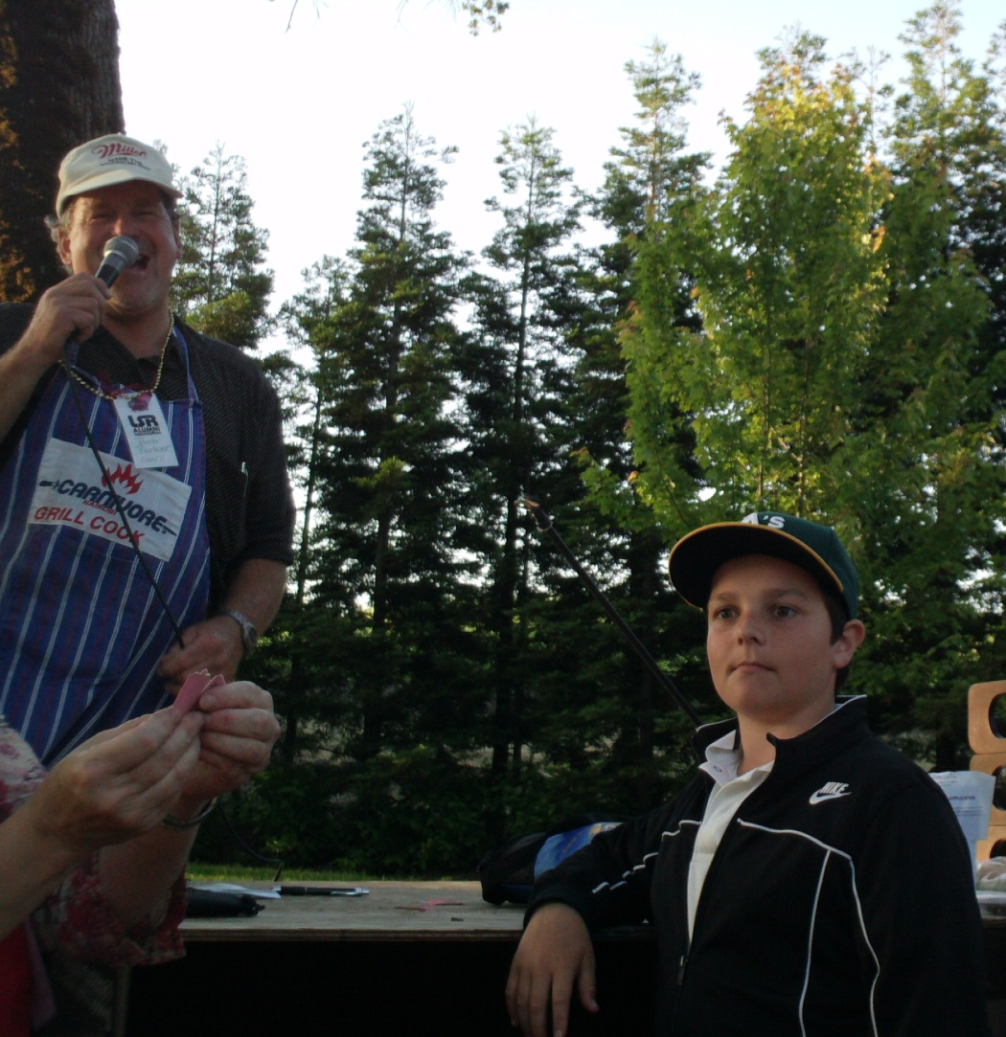
The winning
numbers

Slide 13
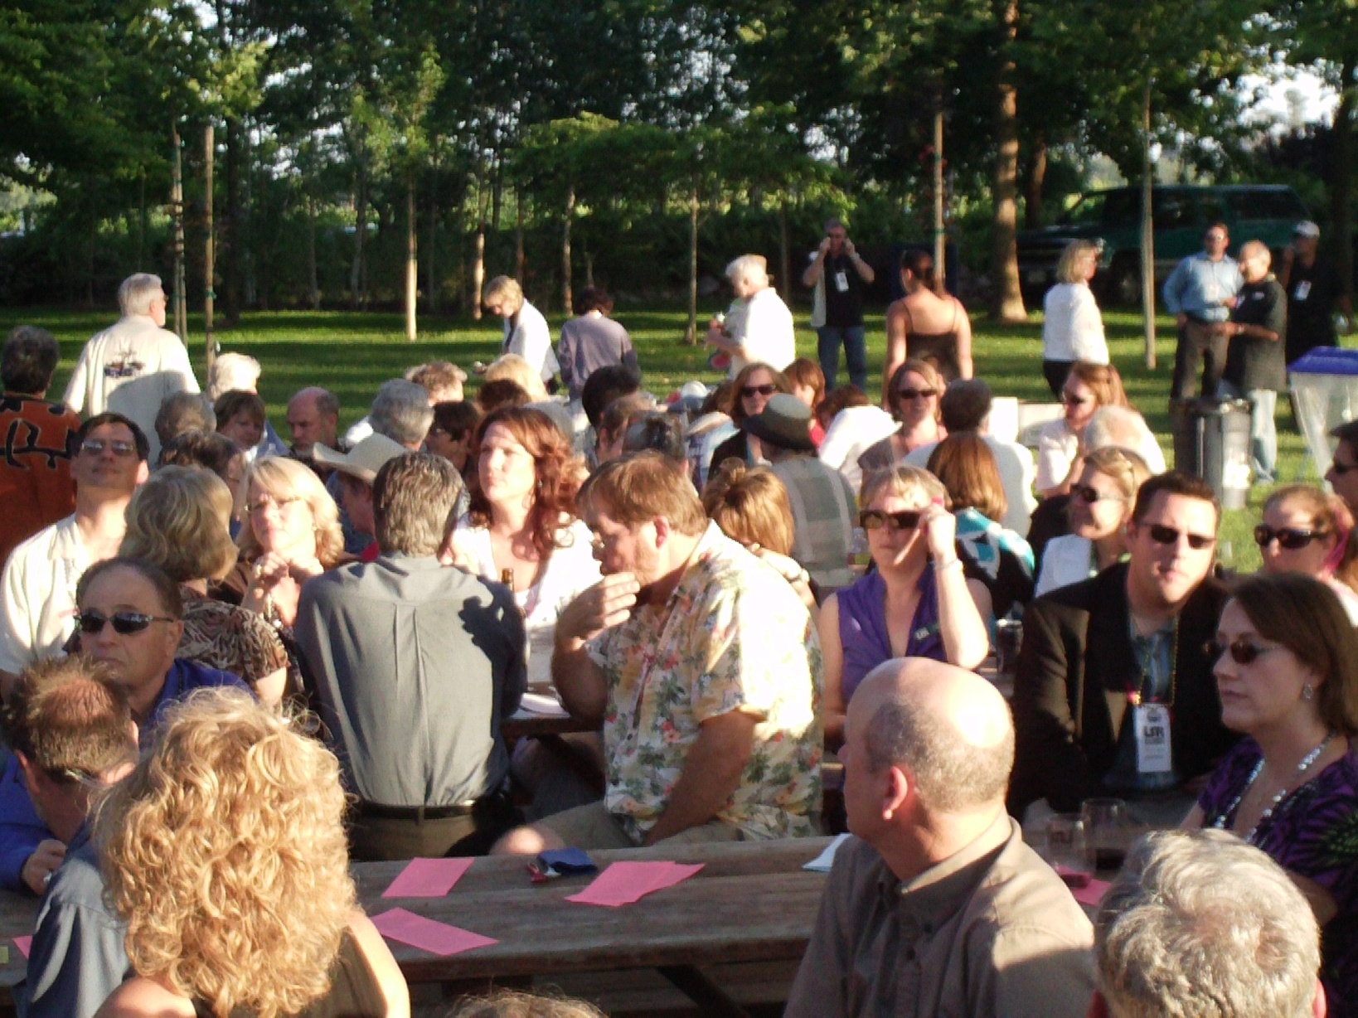
What
Was
the
Number?

Slide 14
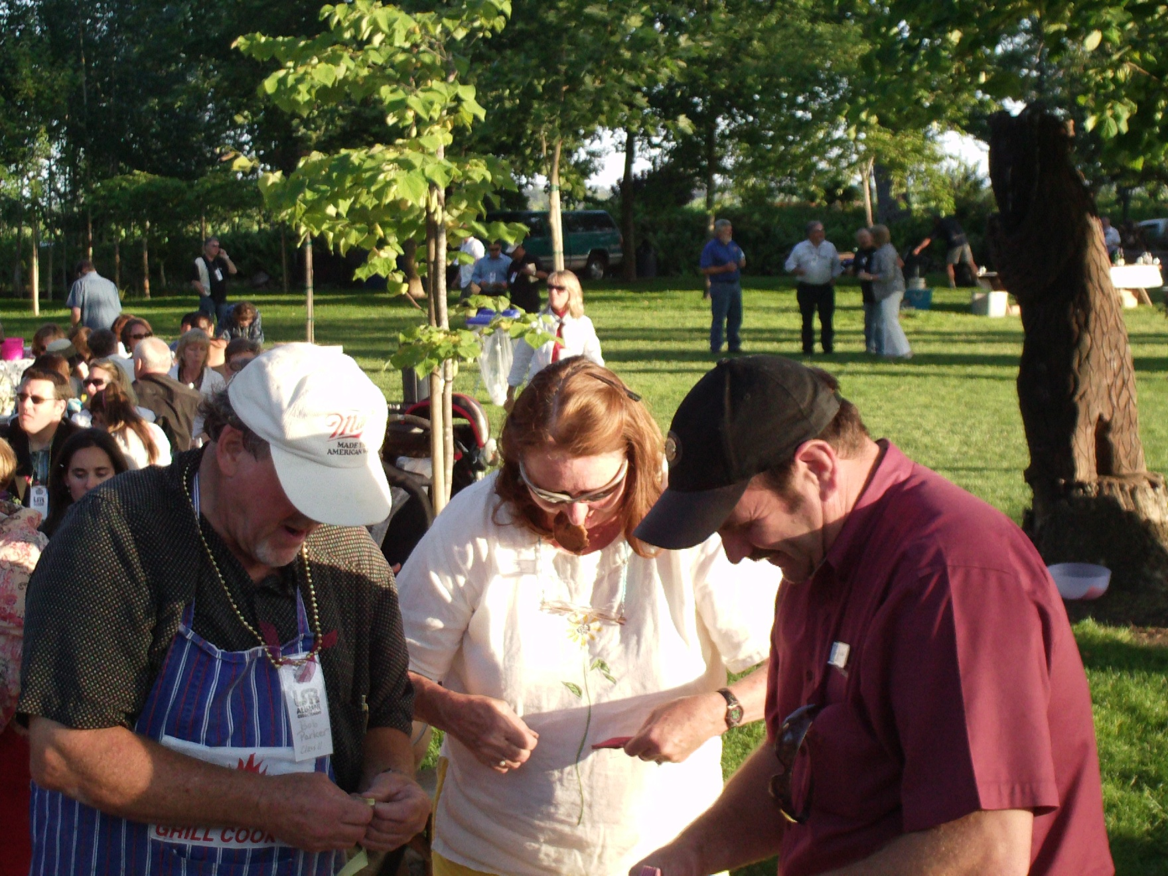
Did
I
Win?

Slide 15
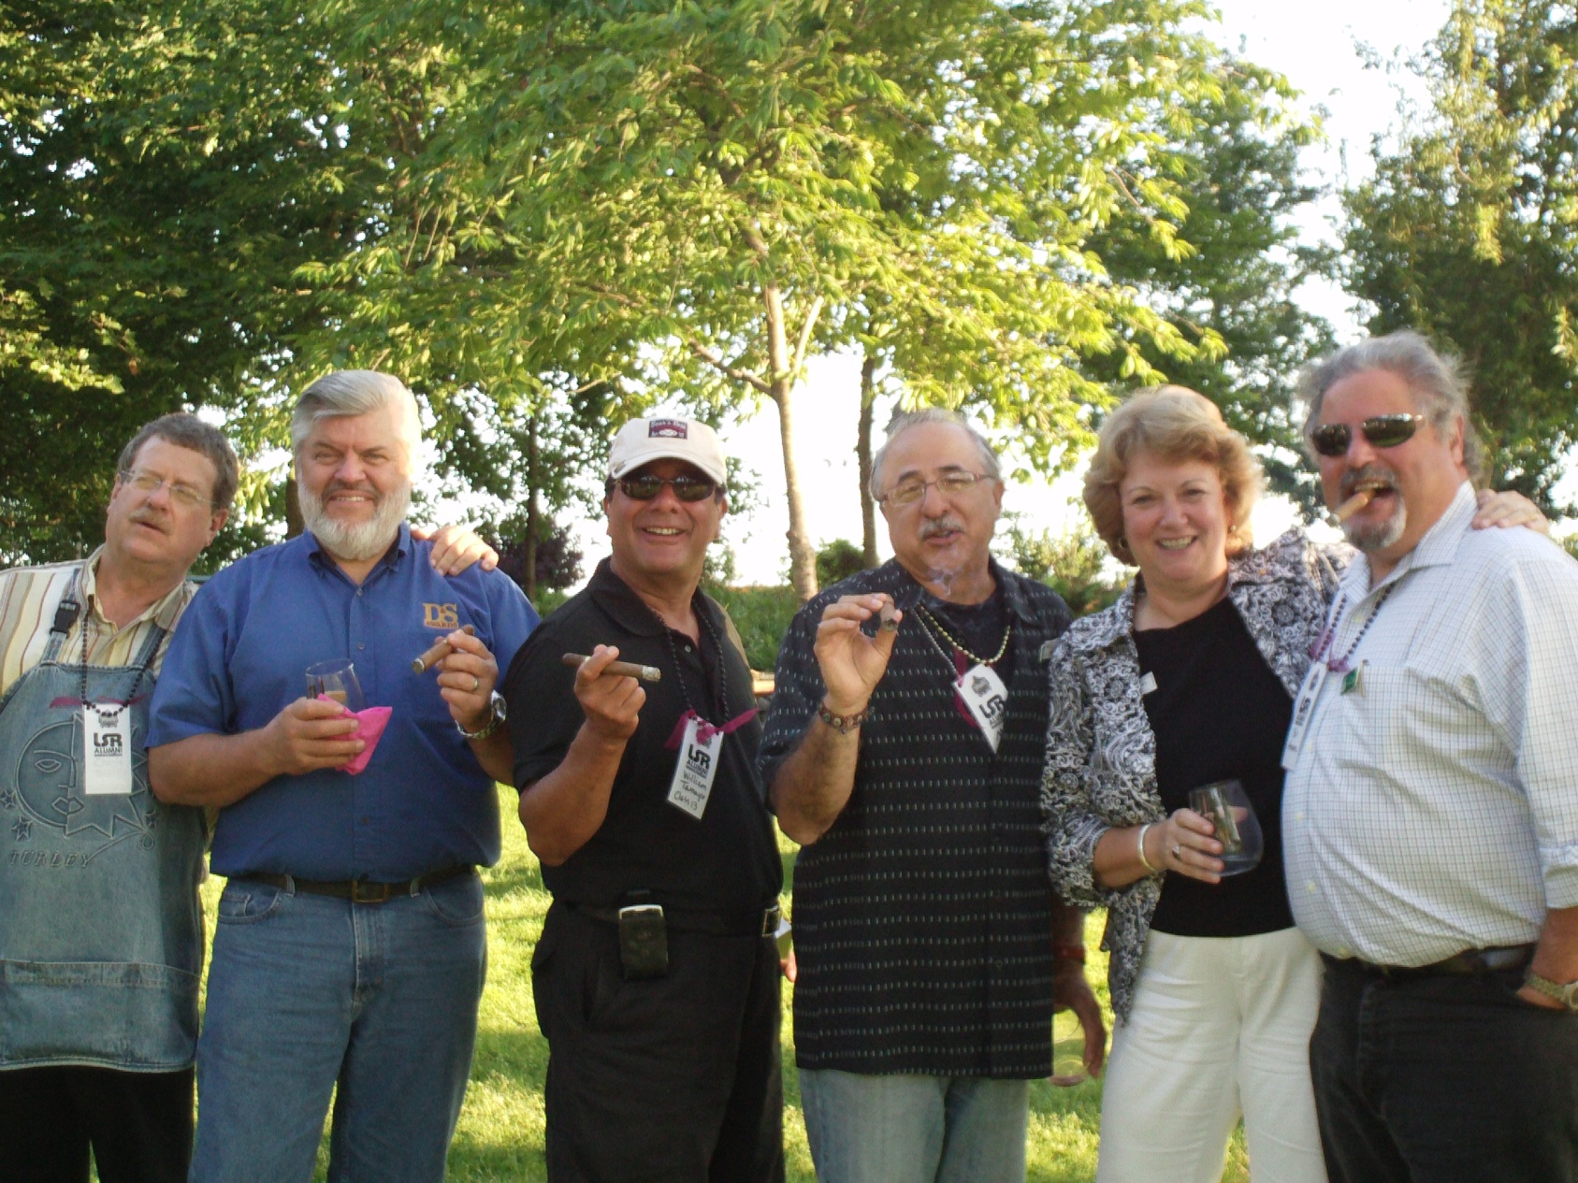
After Dinner Cigars for Everyone

Slide 16
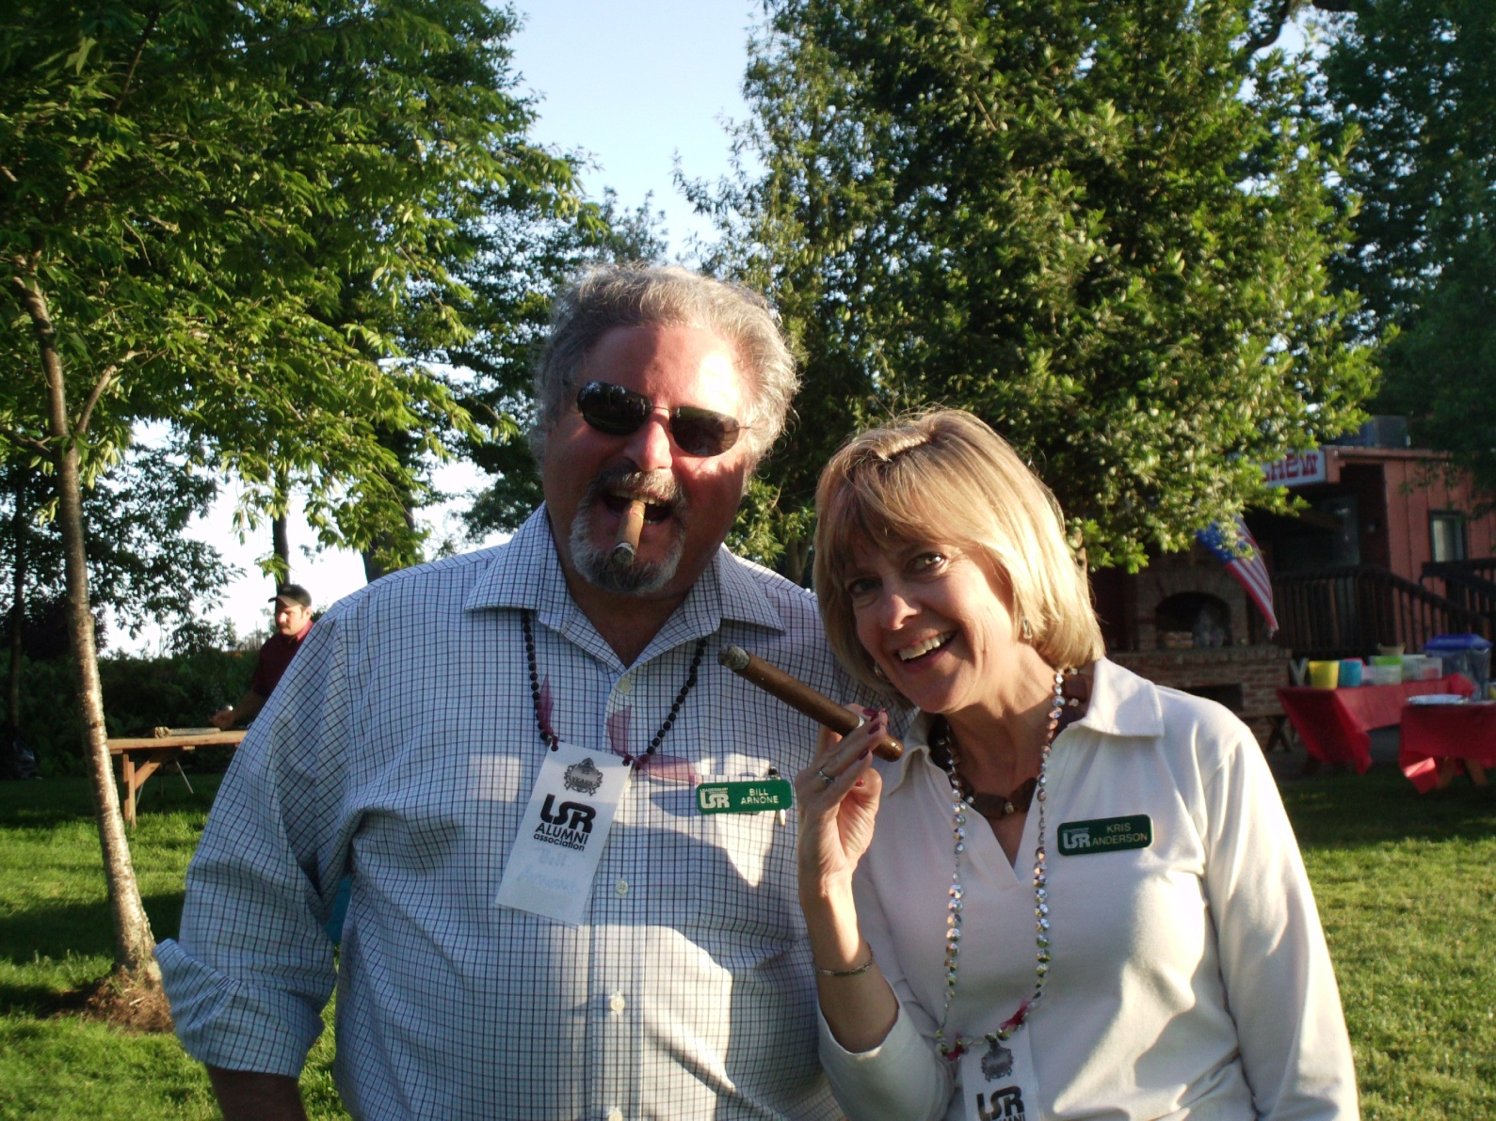
Even
the
Ladies

Slide 17
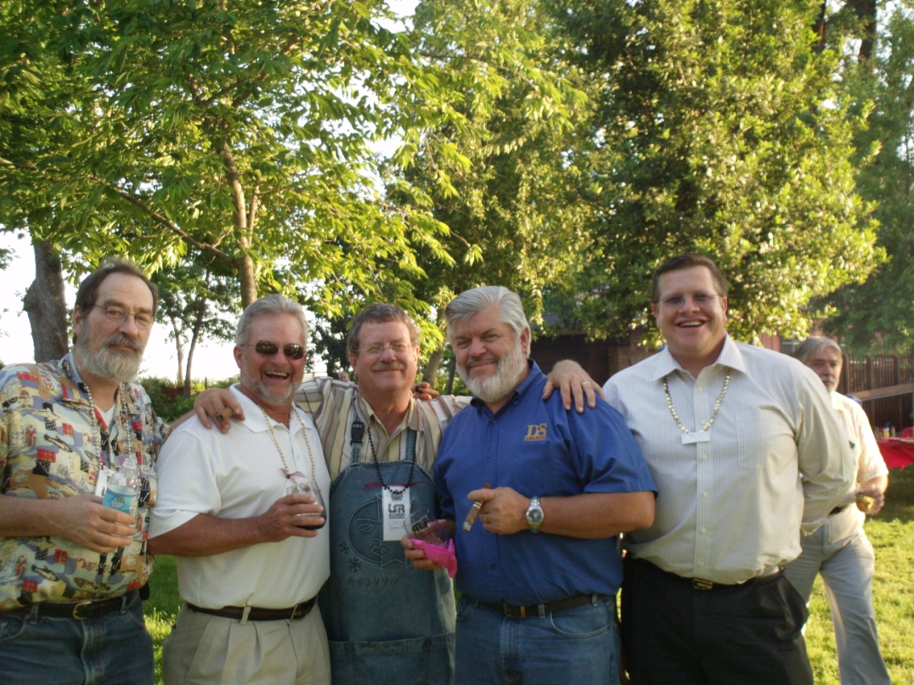
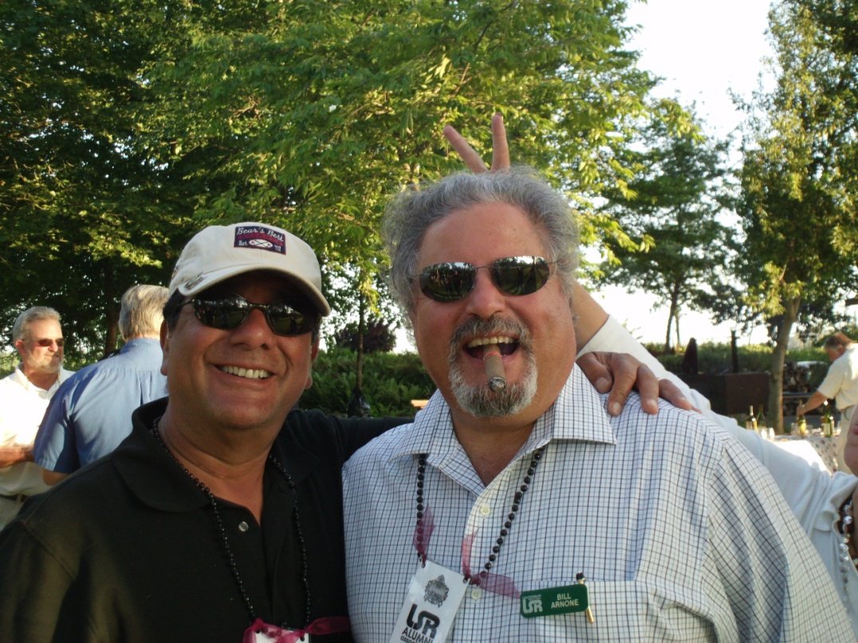
The
Guys…
…Getting
together

Slide 18
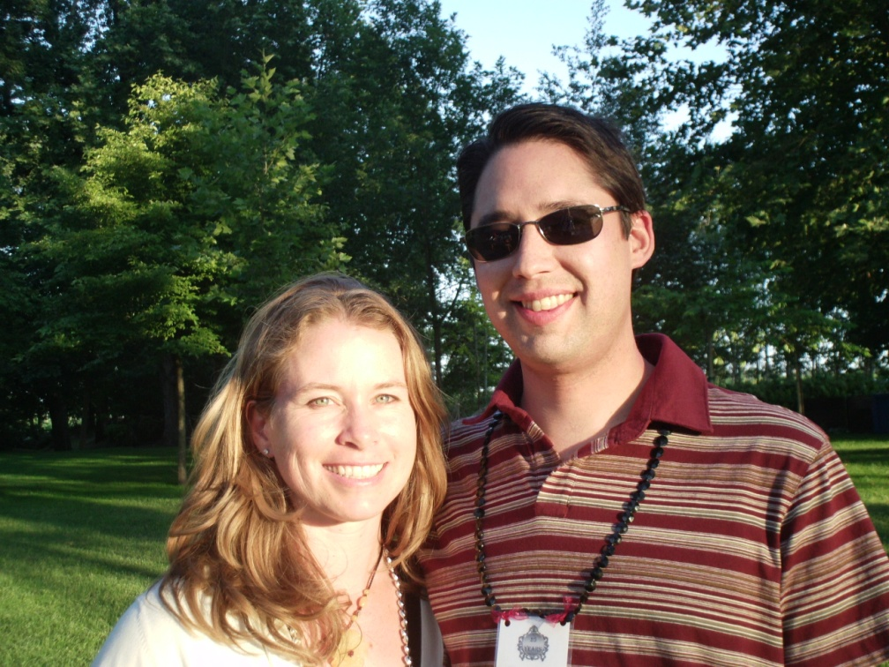
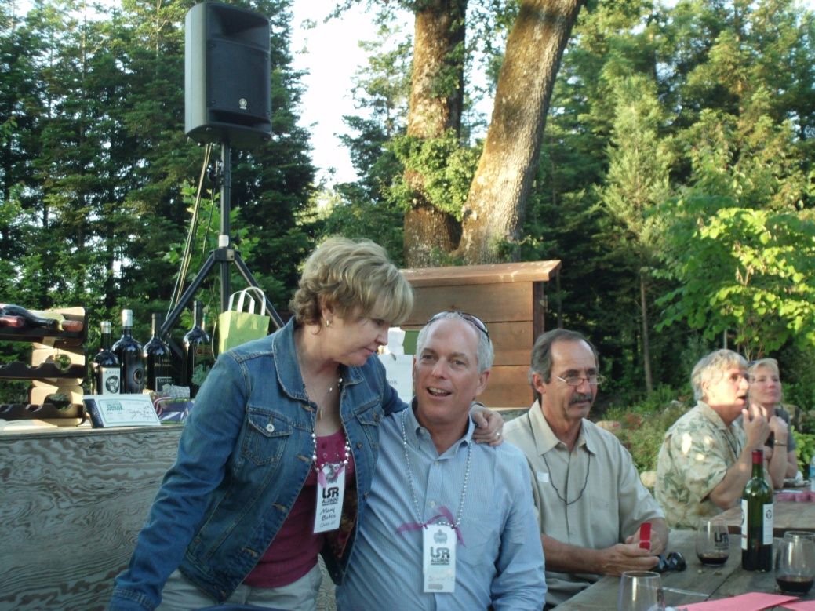
Connecting With…
…Friends & Family

Slide 19
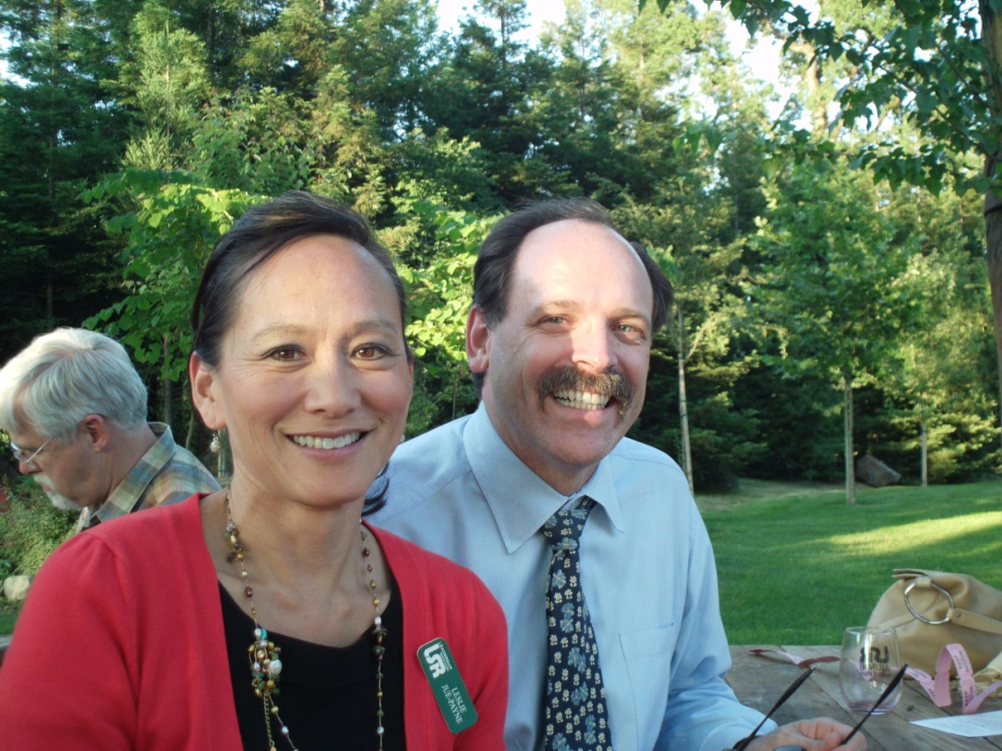
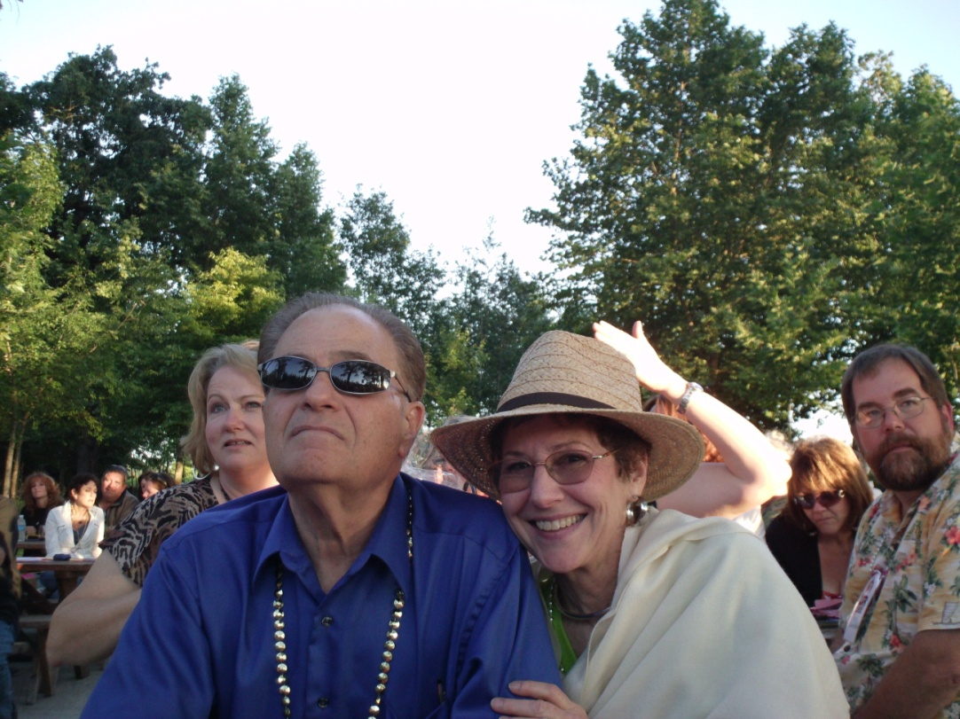
Enjoying the Weather…
…And the Scenery

Slide 20
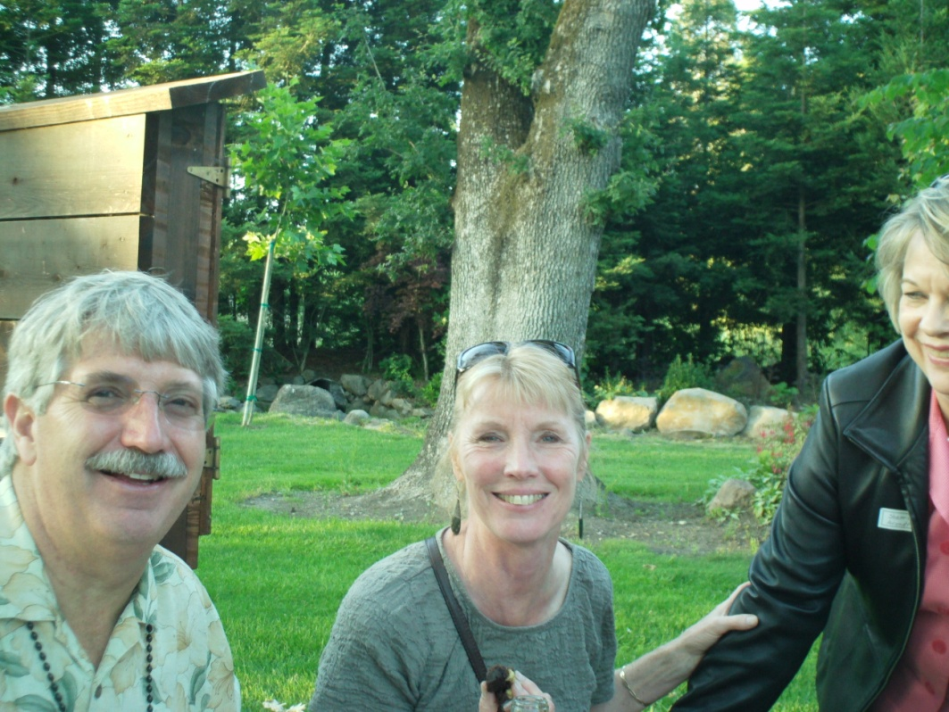
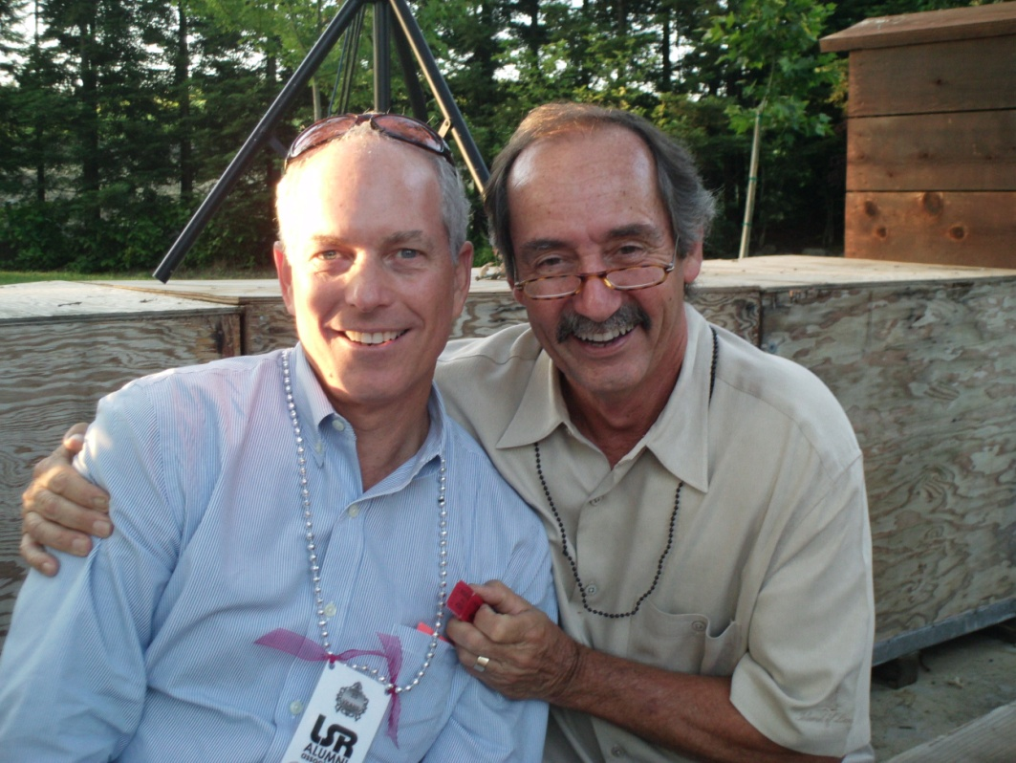
Good Food…
…Good Friends

Slide 21
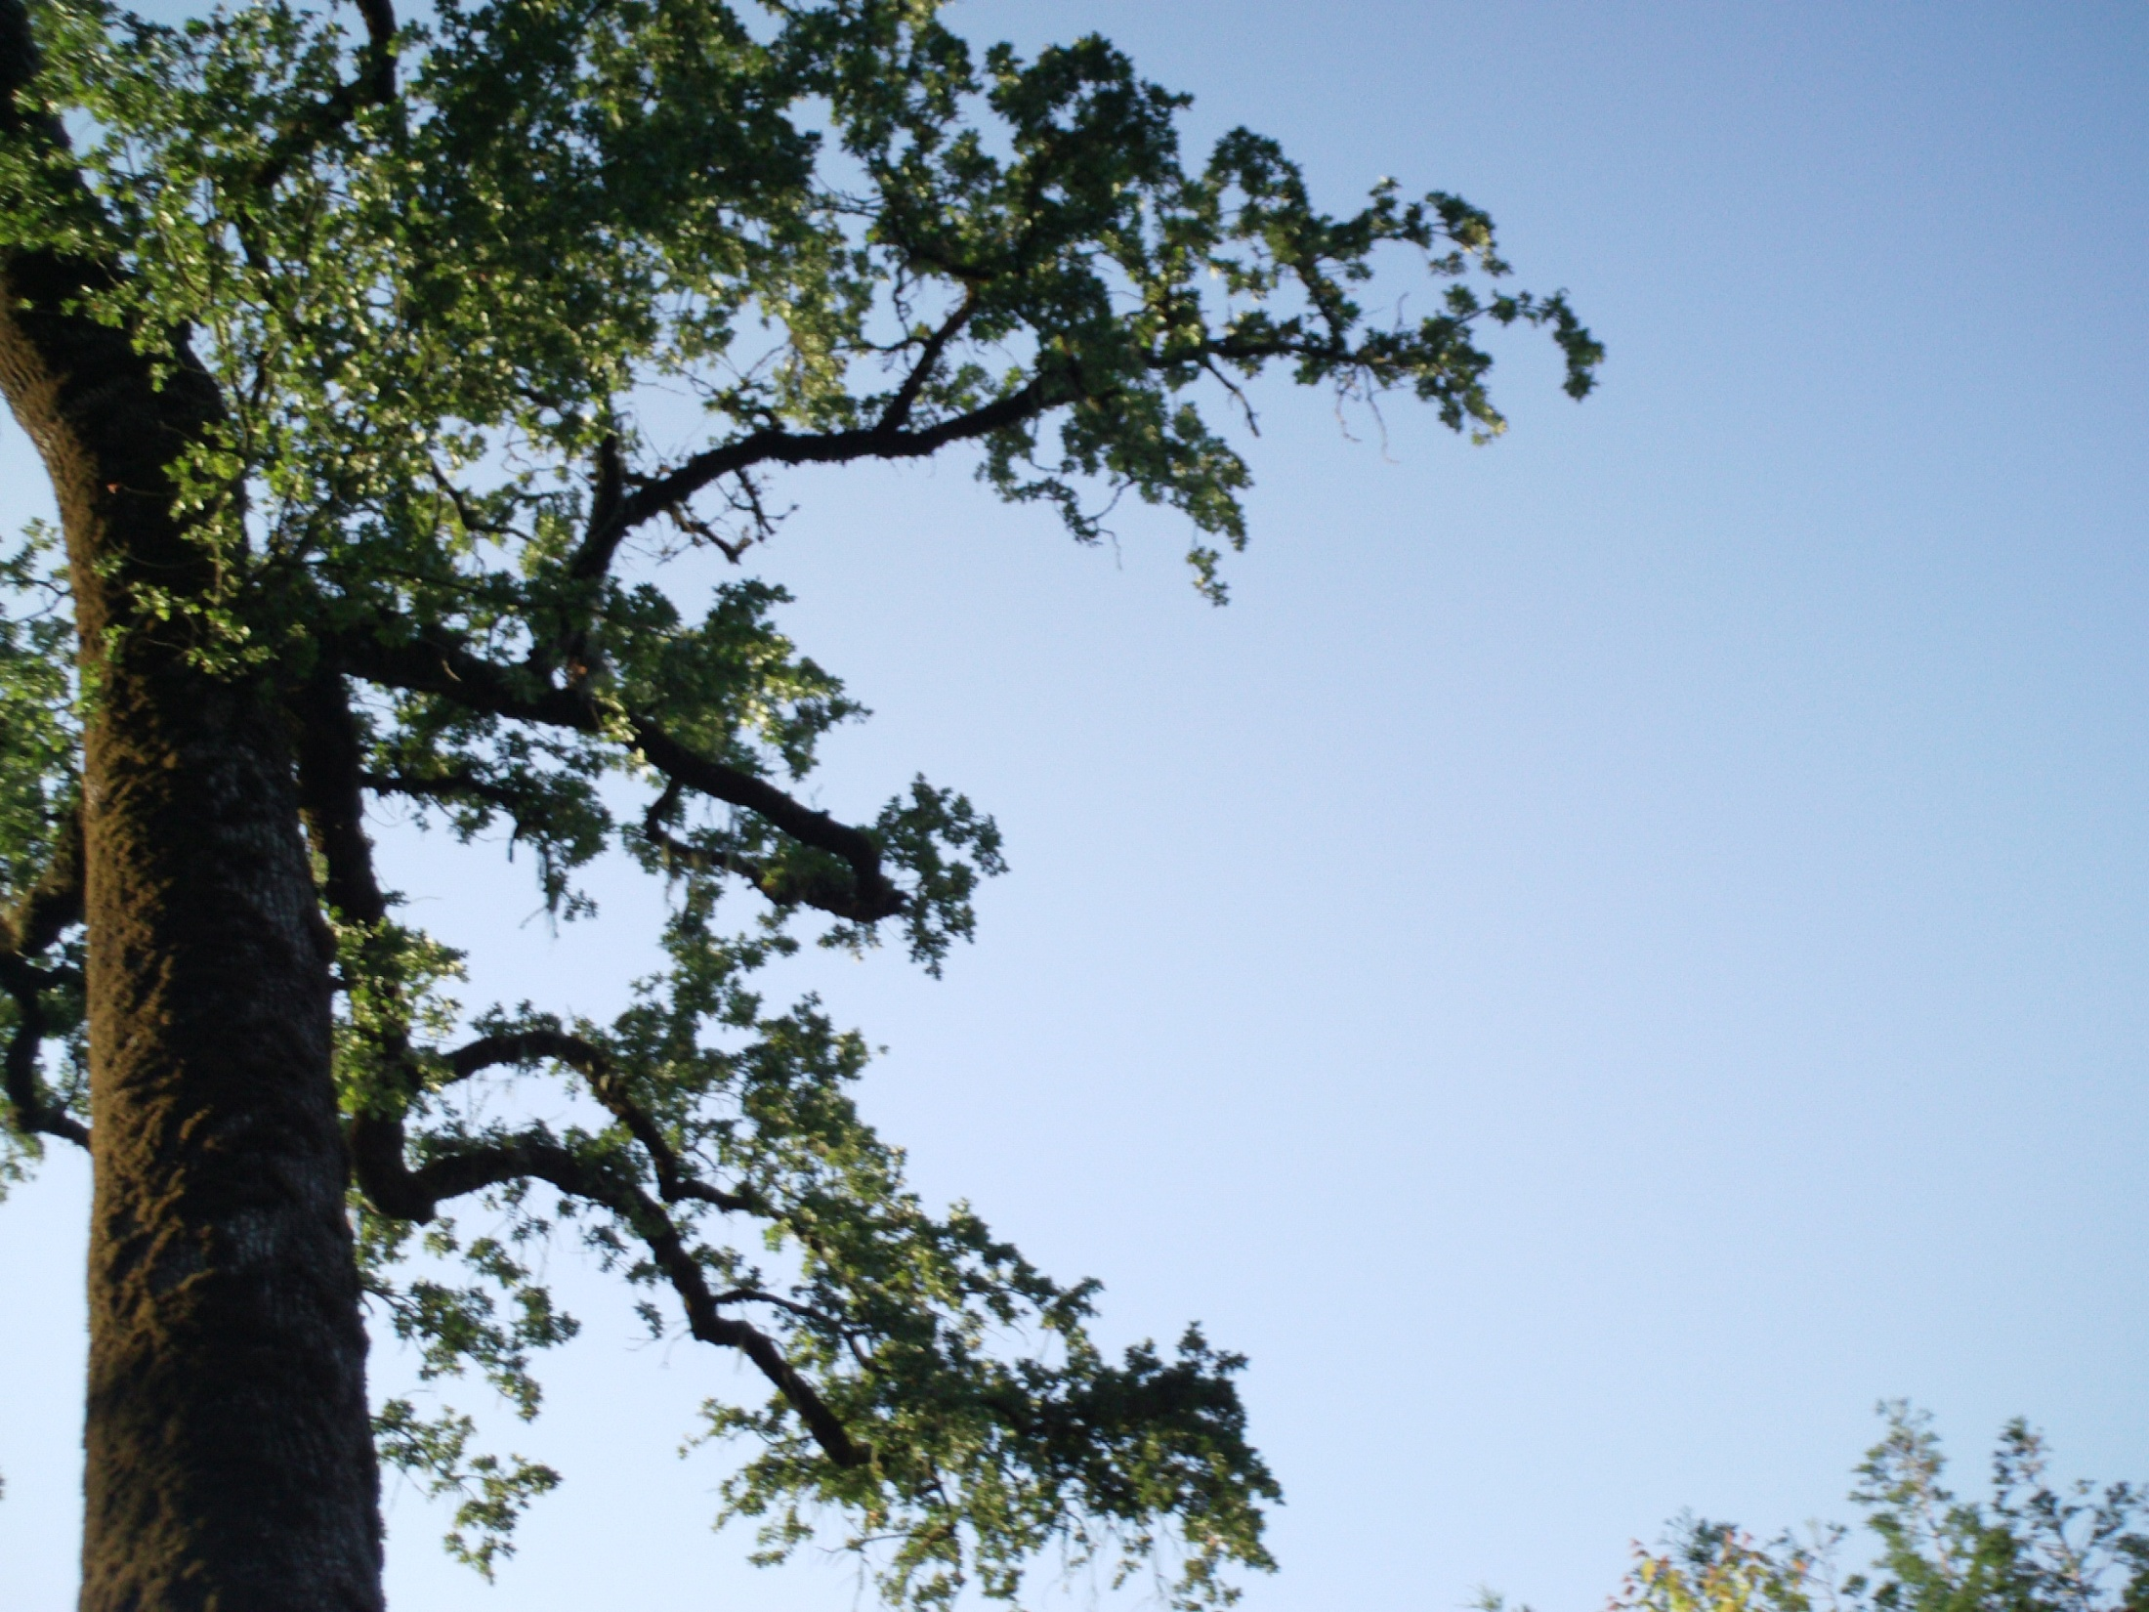
The End of a Perfect Day

